Slide 1
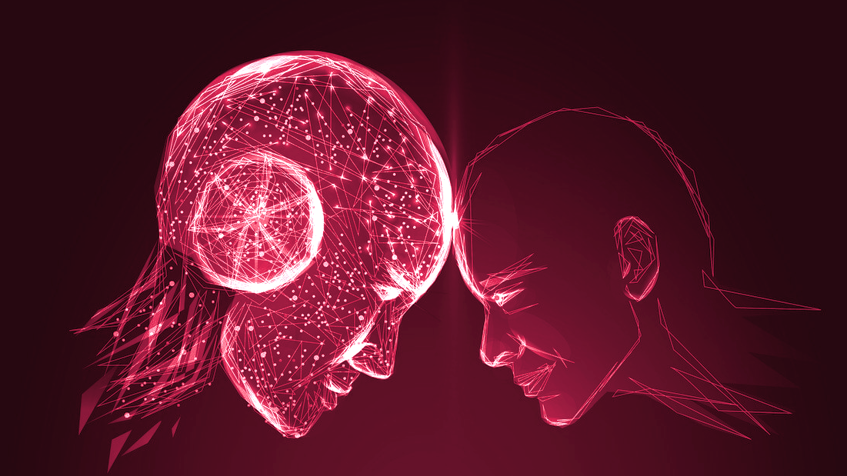
Classifying
Artwork:
AI vs Human
Rainey Fu, Humzah Khan, Tabitha Kim
March 26th, 2023

Slide 2
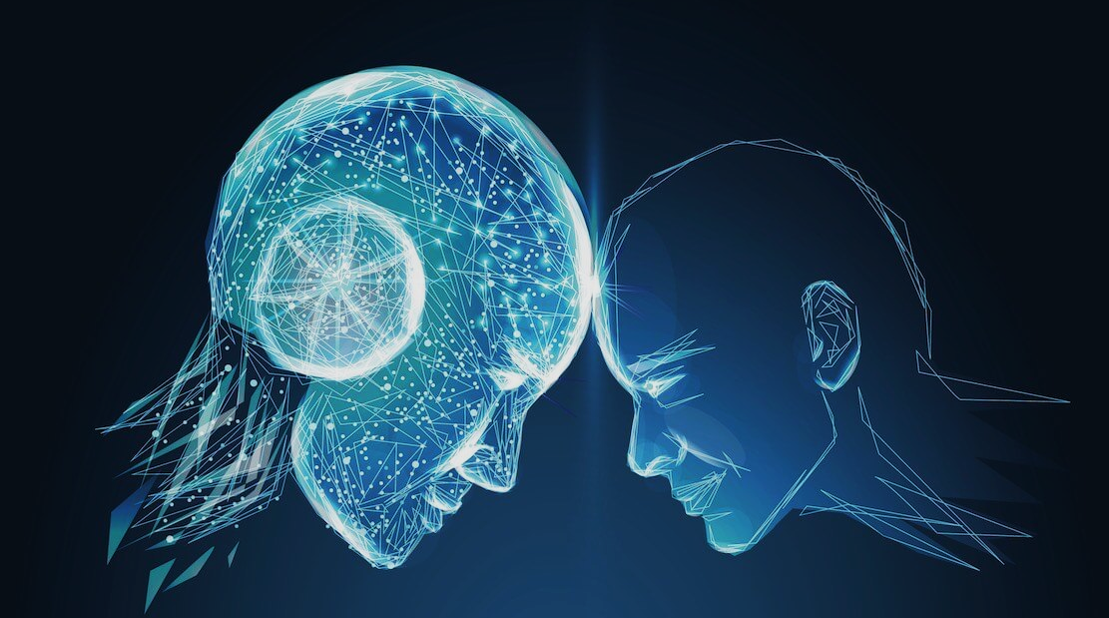
Artifice
Oxford Dictionary
~ clever or cunning devices or expedients, especially as used to trick or deceive others.

Slide 3

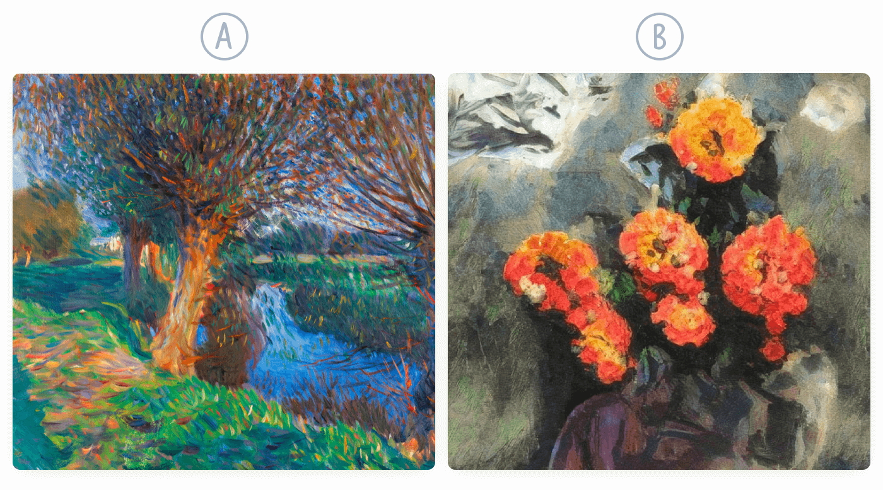
The Need for AI Artwork Detection
The Motivation:
Understanding Authorship
Determining the value of art pieces
Ensuring Legal Compliance

Slide 4
Data Gathering Plan
How This Gets Big
Human Work
Public Datasets
Online Art Communities
Artists Websites
AI Artwork
Public Datasets
AI Art Generators
Mid Journey (250k)
DALL-E (5k)
Stable Diffusion (14M)
Online Galleries
Total: ~ 2 billion data samples
Total: ~ 14.25 million data samples

Slide 5
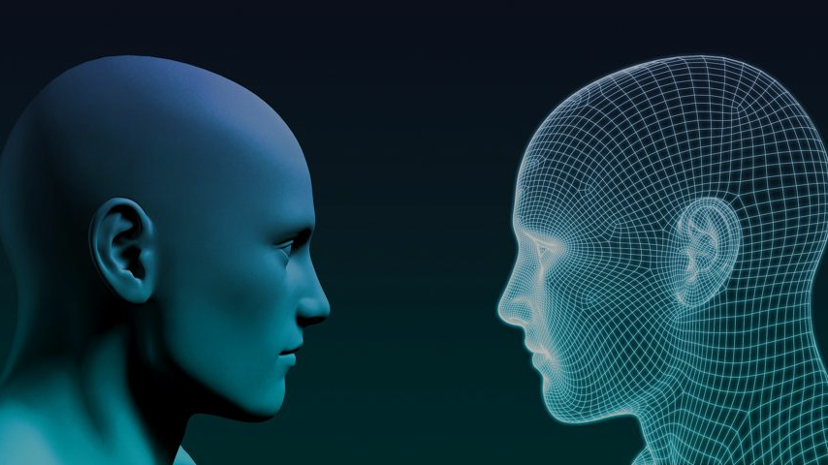
Prior Work
WORK I
“On the Detection of Synthetic Images Generated by Diffusion Models”
WORK II
“Detecting GAN-generated Face Images using Hybrid Texture and Sensor Noise Based Features”
Notes:
The main prior work that we’ve pulled inspiration from were first, the study on the detection of synthetic images generated by diffusion models and secondly the study on detecting GAN-generated face images using hybrid texture and sensor noise based features

Slide 6
On the Detection of Synthetic Images Generated by Diffusion Models
R. Corvi, D. Cozzolino, G. Zingarini, G. Poggi, K. Nagano, and L. Verdoliva
Distinction between synthetic vs pristine images using generalized detectors
Shows forensic traces left by popular diffusion models (Stable Diffusion, Latent Diffusion, GLIDE)
Finds weaker traces in models DALLE2 and ADM
Good result using ResNet-50 model
Lists important ways to improve performance
Notes:
In the first study, the researchers investigated the distinction between synthetic images generated by diffusion models and pristine images by using generalized detectors.
In their research, they were able to find that popular diffusion models, such as Stable Diffusion, Latent Diffusion, and GLIDE left strong peaks while the images generated from DALLE2 and ADM left weaker traces.
We wanted to highlight the fact that they had a good result when using the ResNet-50 model as we expand on it in our project
They also listed ways to improve the performance of the detector which was something we could benefit from

Slide 7
On the Detection of Synthetic Images Generated by Diffusion Models
KEY TAKEAWAYS:
Improving Performance:
Avoid compression and resizing to avoid loss of information
Pre-training models on large datasets can improve performance
Using residuals as input and extreme augmentation provide marginal benefits
Notes:
Their suggestions on improving the accuracy were avoiding compression and resizing to prevent information loss, and pre-training models on large datasets like ImageNet. The study also found that using residuals as input and extreme augmentation only provide marginal benefits.
We thought these points were the main takeaways from this study that were applicable to our project

Slide 8
Detecting GAN-generated face images via hybrid texture and sensor noise based features
T. Fu, M. Xia, and G. Yang
Differentiates AI generated vs natural human faces
Dataset includes StyleGAN-generated AI images and a small image database of 4000 human faces
Achieves up to 97.6% accuracy using the hybrid features approach
Sensor Noise Feature: observe sensor noise patterns
Texture Feature: deep learning approach — CNN
Notes:
Our second study, focuses on differentiating AI-generated and natural images of human faces. It especially focuses on GAN-generated faces, which apparently are very hard to detect with the human eye. The dataset they used included StyleGAN-generated AI images and an image database of 4000 real human faces.
Something to highlight was that to accurately detect AI-generated images with up to 97.6% accuracy, they used a combination of sensor noise and texture features.
They collected sensor noise features by observing the unique sensor noise patterns, and extracted the texture features using a deep convolutional neural network. They then inputted both features to a support vector machine, which successfully outputed the prediction of whether the face was GAN-generated or not.

Slide 9
Detecting GAN-generated face images via hybrid texture and sensor noise based features
OUTCOMES:
Successful classification of AI-generated and human faces using the hybrid features approach
Importance of using a combination of features for accurate detection
Potential to scale this approach to other AI-generated images (Artwork)
Notes:
The outcomes of the study highlight the importance of using a combination of features for accurate detection, and the potential to scale this approach to other AI-generated images such as artwork that we are focusing on.

Slide 10
Dataset
We use a custom dataset combined of public datasets:
LAION for authentic images
Kaggle/Hugging Face datasets for Stable Diffusion, Midjourney, and Dalle 2 images

Slide 11
Dataset
We use a custom dataset combined of public datasets:
LAION for authentic images
Kaggle/Hugging Face datasets for Stable Diffusion, Midjourney, and Dalle 2 images

Slide 12
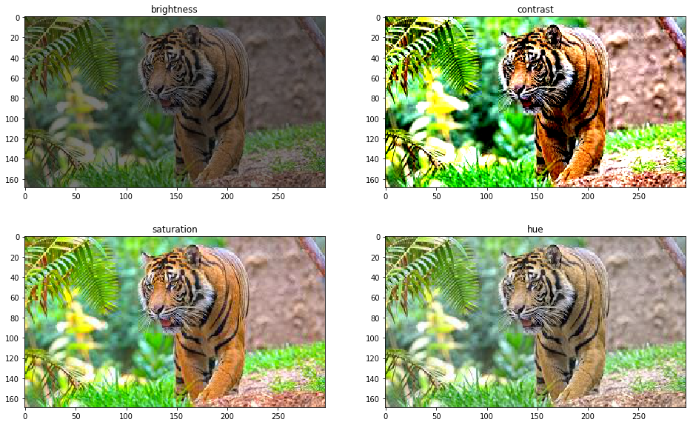
Data Augmentations
Random Horizontal Flip (p=0.5)
Random Rotation (15 degrees)
Random Crop (scale = (0.8, 0.1), ratio = (0.75, 1.333))
Color Jitter (brightness=0.2, contrast=0.2, saturation=0.2, hue=0.1)

Slide 13
Data Augmentations
Random Horizontal Flip (p=0.5)
Random Rotation (15 degrees)
Random Crop (scale = (0.8, 0.1), ratio = (0.75, 1.333))
Color Jitter (brightness=0.2, contrast=0.2, saturation=0.2, hue=0.1)

Slide 14
Model and Techniques
We use a pre-trained ResNet-101 with Cross-Entropy Loss and a fully connected 4 output layer. Previous work saw good results using ResNet-50.
We also use:
Batching
Adaptive learning rate
Adam optimizer

Slide 15
Model and Techniques
We use a pre-trained ResNet-101 with Cross-Entropy Loss and a fully connected 4 output layer. Previous work saw good results using ResNet-50.
We also use:
Batching
Adaptive learning rate
Adam optimizer

Slide 16
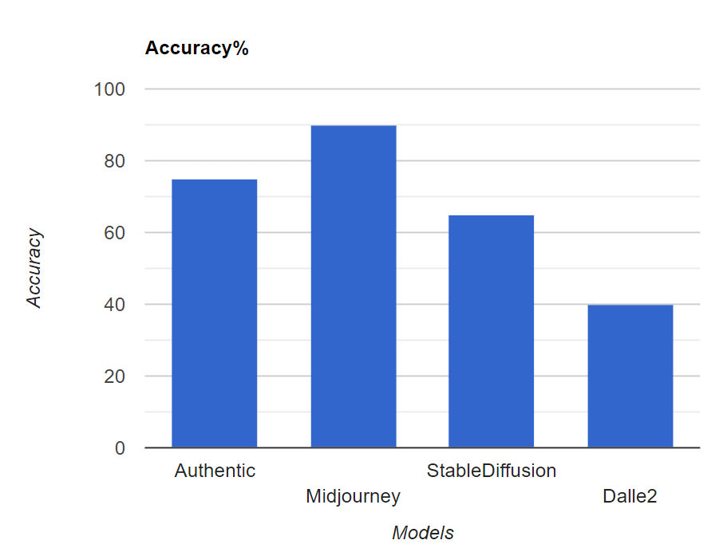
Training
Results

Slide 17
Training Results

Slide 18
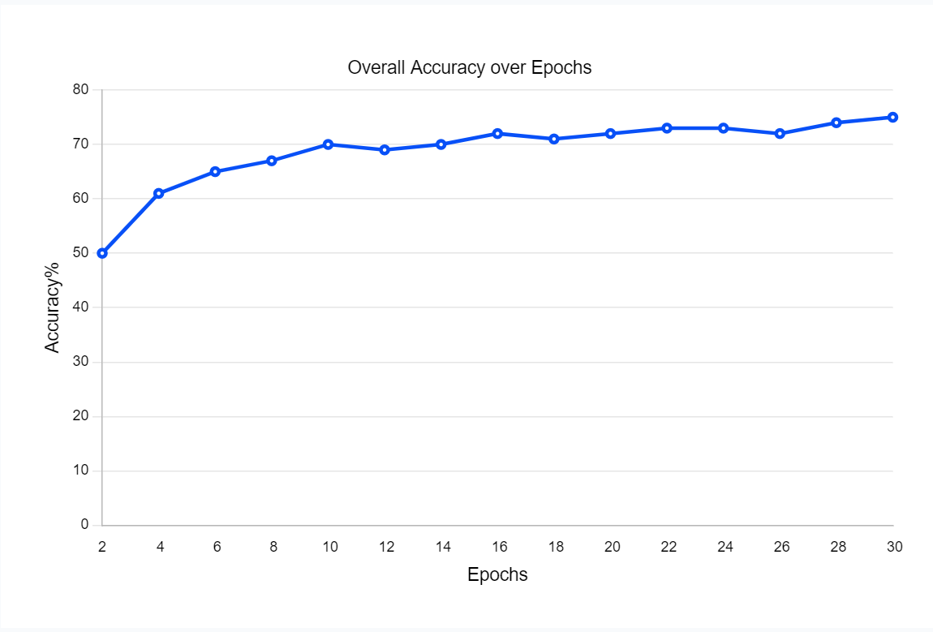
Training
Results

Slide 19
Training Results

Slide 20
Issues
Resnet-101 is computationally expensive, takes a long time to train and a lot of RAM.
Too much data, not enough resources. Google collab has limits on RAM, we cannot load all of our data to train at once.

Slide 21
Issues
Resnet-101 is computationally expensive, takes a long time to train and a lot of RAM.
Too much data, not enough resources. Google collab has limits on RAM, we cannot load all of our data to train at once.

Slide 22
To Do
Tune hyperparameters:
Learning rate, epochs, batch size, data augmentations
Find ways to optimize RAM usage to fully utilize dataset

Slide 23
Todo
Tune hyperparameters:
Learning rate, epochs, batch size
Find ways to optimize RAM usage to fully utilize dataset

